Slide 1
Initial Results in Semiconductor Manufacturing Plasmas
David Caron
West Virginia University – Scime Group
16 August 2018
Princeton Plasma Physics Lab – Graduate Summer School

Slide 2
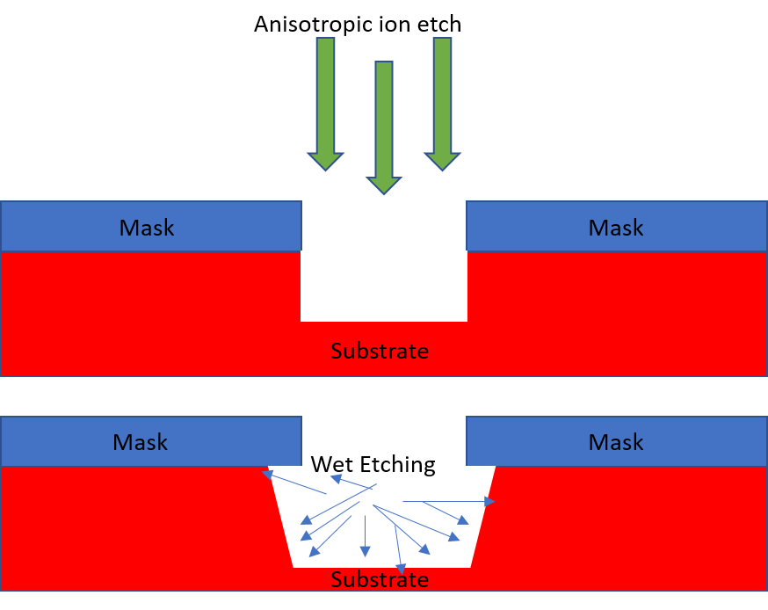
Industry Plasmas
Plasma is used for semiconductor etching and doping.
Provides more controllable, anisotropic etches compared with “wet” etching.
Much more green, no need for harmful chemicals

Slide 3
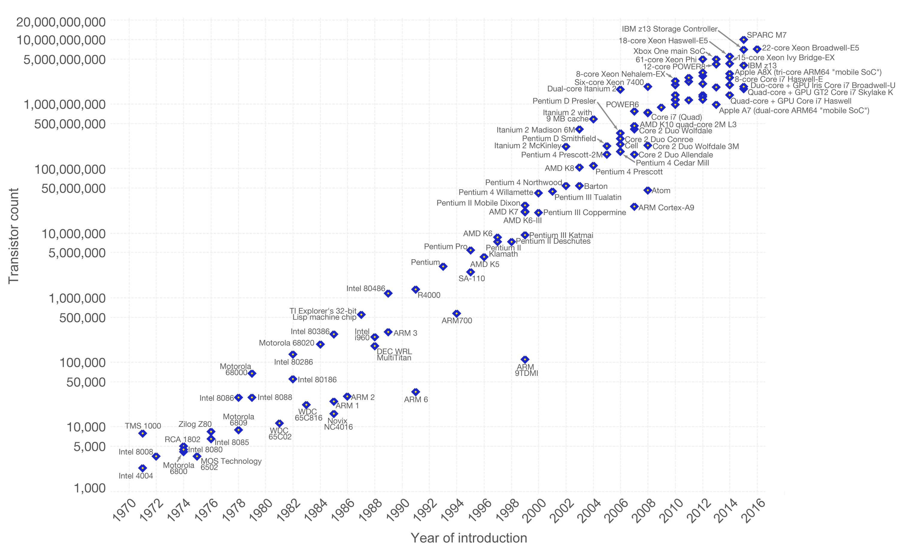
Moore’s Law
Fig. 2

Slide 4
Transistors
Semiconductor features are reaching the nanoscale
Silicon atoms are ~.2nm in diameter
  We are reaching a natural limitation
Smallest defect will greatly affect overall performance.
Fig. 3

Slide 5
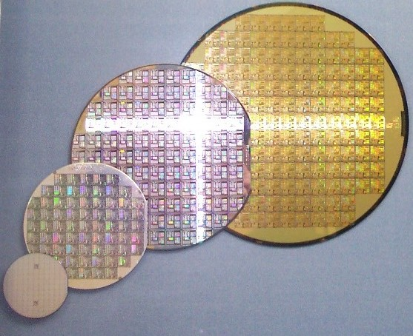
Keep Moore’s Law Alive
We must find a way to keep increasing processing power
Start building 3-dimensionally
  Die-to-Die
  Die-to-Wafer
  Wafer-to-Wafer
We want a singular, 3-dimensional semiconductor
Fig. 4

Slide 6
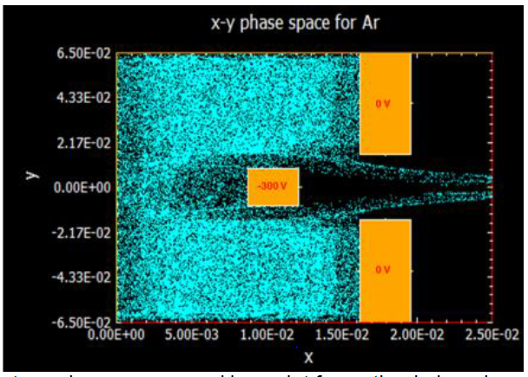
Controllable Ion Beamlets
NSF GOALIE Grant: Optimization of Ion Beam Extraction – Enabling Technology For Advanced Semiconductor Fabrication
Use LIF to investigate ion velocities and angular distribution dependences on source parameters.

Slide 7
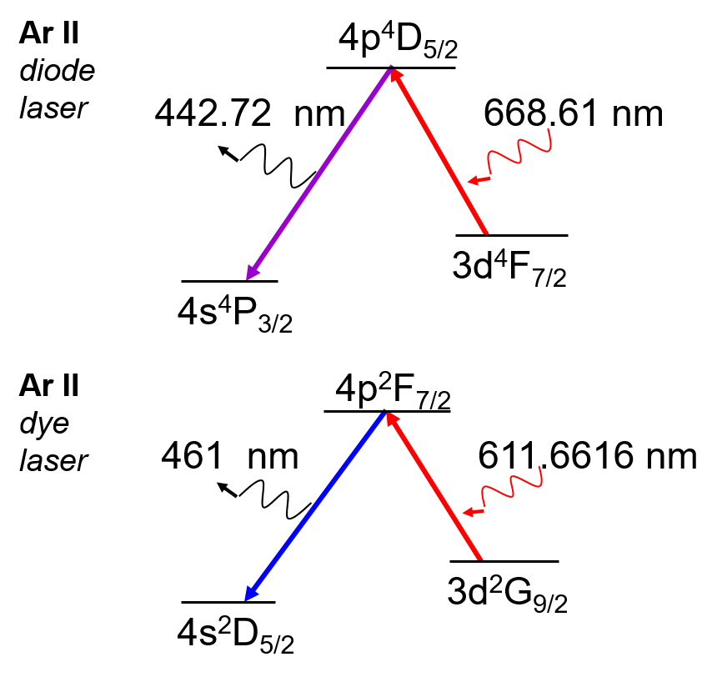
LIF
Use laser to excite an electron to a higher state
Collect emitted light when electron falls to more stable orbit
Depending on velocity of ion it will “see” different wavelength of injected light
  Can use this Doppler shift

Slide 8
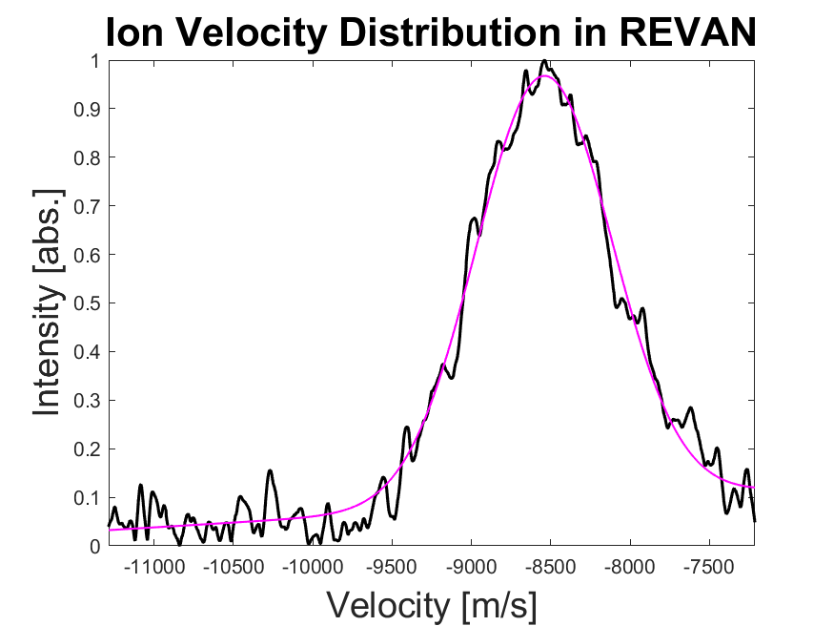
LIF
Scan laser over frequency range
Assume Maxwellian Distribution
Fit Gaussian to IVDF
  Area under curve → Density
  Offset → Velocity
  Width → Temperature

Slide 9
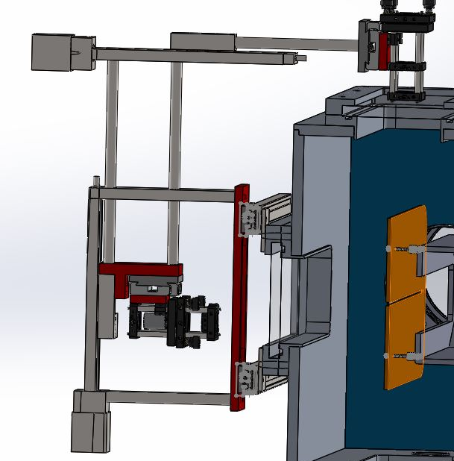
LIF
2D Stage
Standard LIF needs two points of optical access
Inject collimated beam to excite ions
Collected with a focused optics to give localized measurement in plasma
With enough optical access we can map the density, velocity, and temperature of the whole plasma

Slide 10
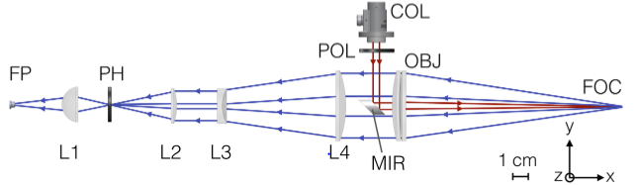
LIF
Developed at WVU
Allows for collection and injection along the same optical path
Lets us measure previously forbidden regions of plasmas such as in antenna
Many applications outside of plasma physics
  Medicine, additive manufacturing, etc.
Confocal LIF
D.S. Thompson (2017)

Slide 11
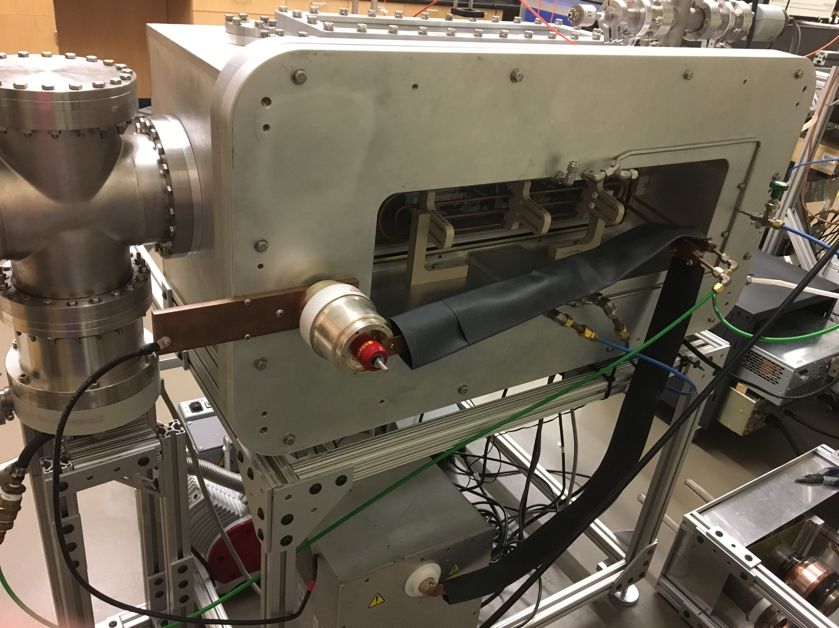
Ribbon Experiment for Velocity and Angular distribution (REVAN)

Slide 12
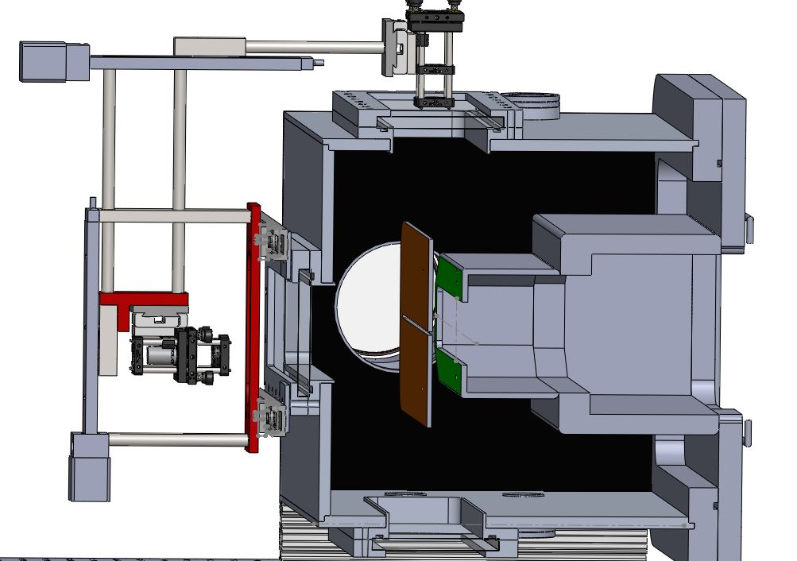
REVAN
Orange plate mimics silicon wafer
  Biased relative to plasma source
Green marks exchangeable extraction optics
  Different blocker geometry can create a double or single beamlet
Source parameters:
  Pressure
  Power
  Extraction Voltage

Slide 13
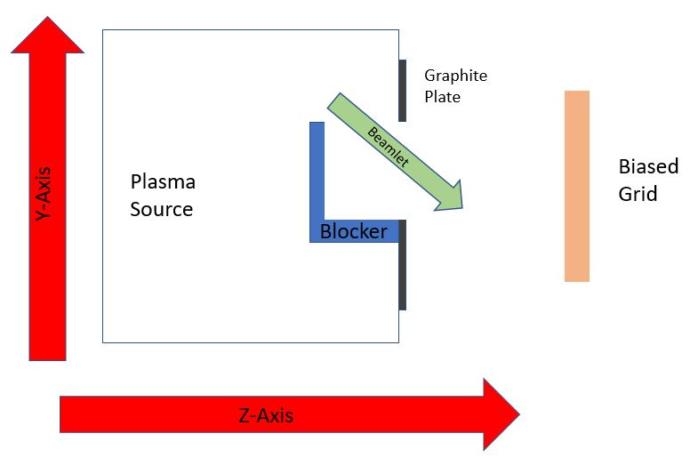
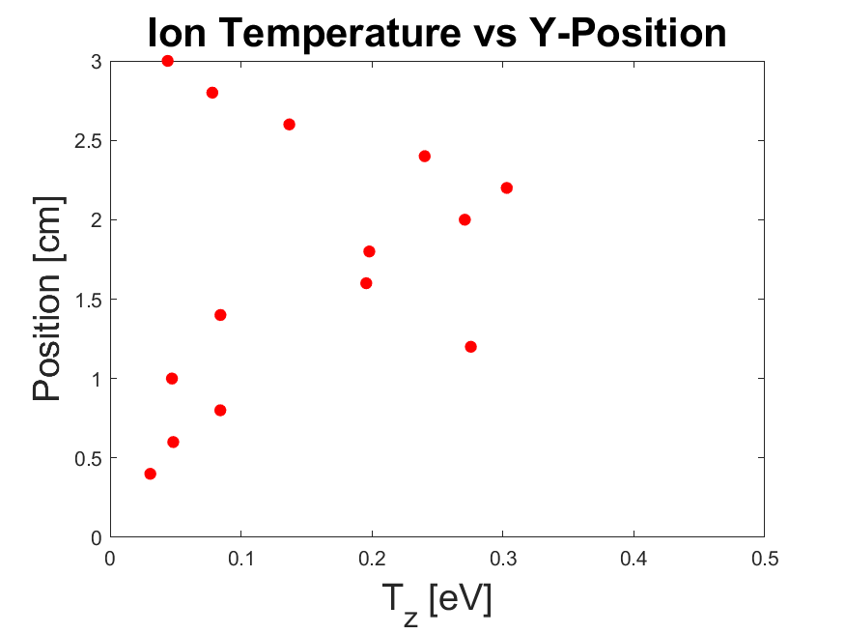
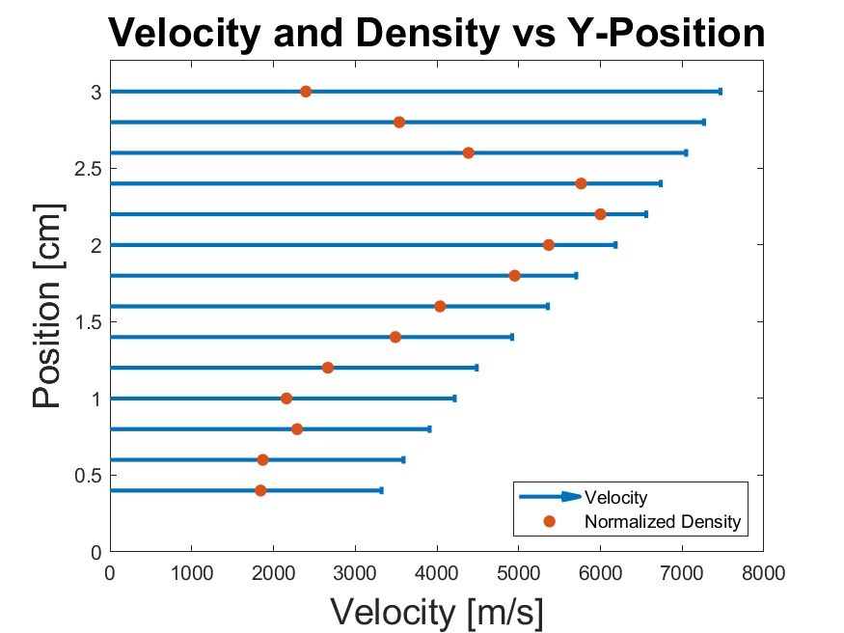
Results
Held source parameters constant
Looked “up and down” for beamlet

Slide 14
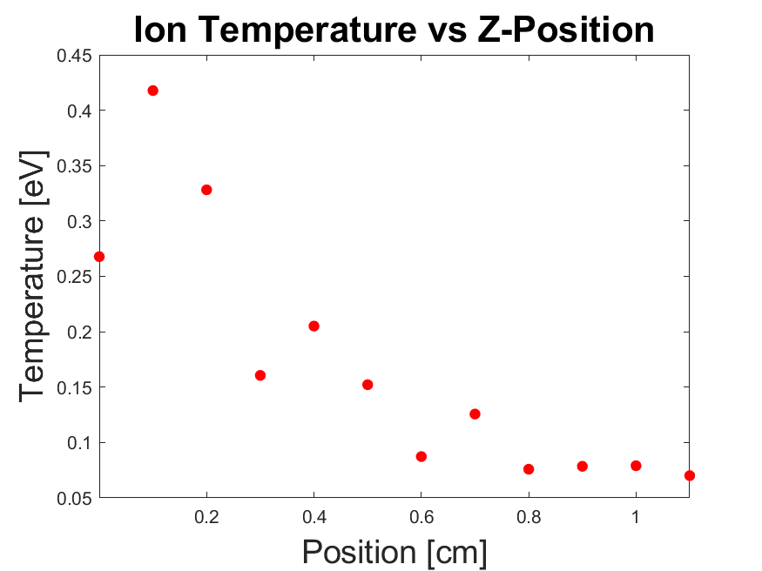
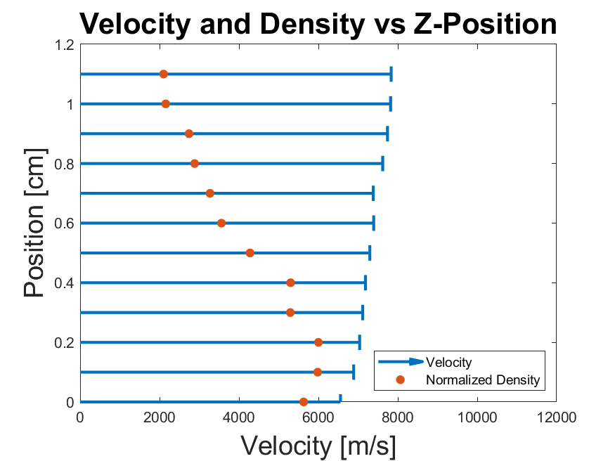
Results
Held source parameters constant
Looked “left and right” for beamlet

Slide 15
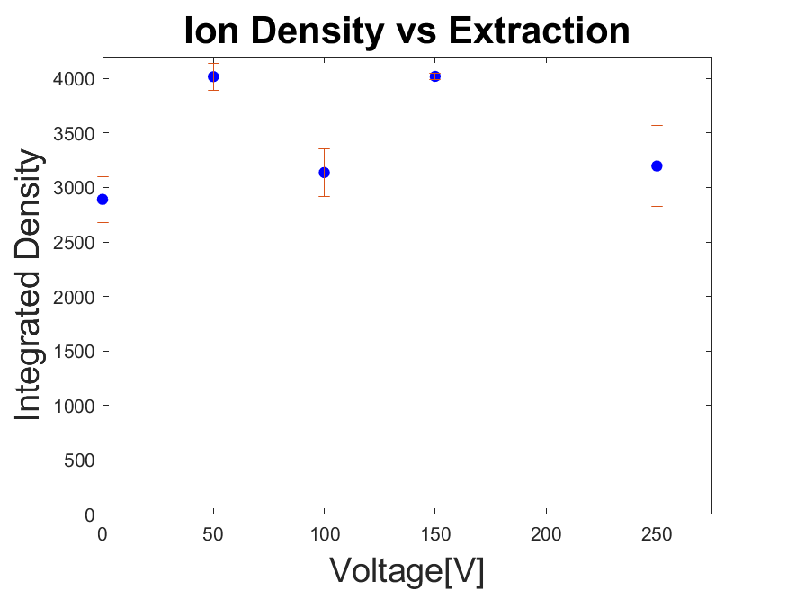
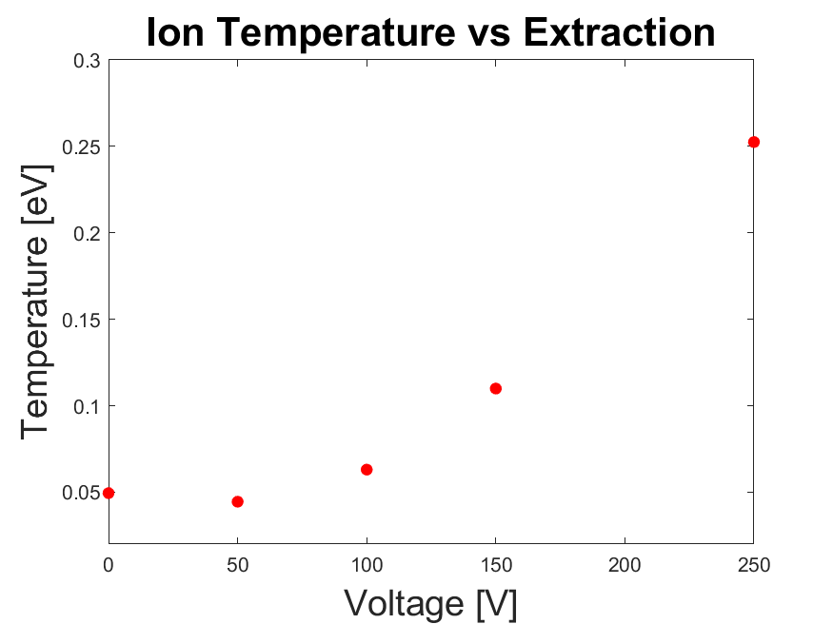
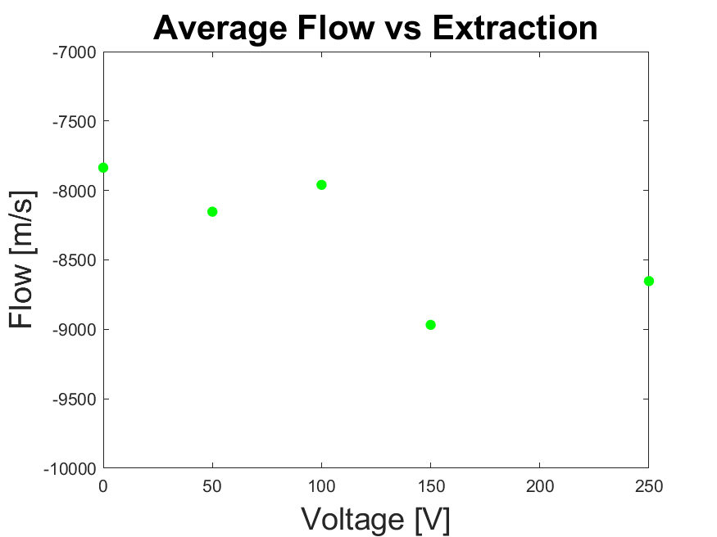
Extraction
Pressure, Power and Position are held constant
Varied the bias on the “wafer”

Slide 16
Results and Looking Forward
We have confirmed the existence of an ion beamlet in REVAN
Failed to see velocity increase with extraction voltage
  Most likely not in “wafer” sheath
Improve ion signal
Create an ion density map of the beamlet
Investigate new biased “wafer” structure

Slide 17
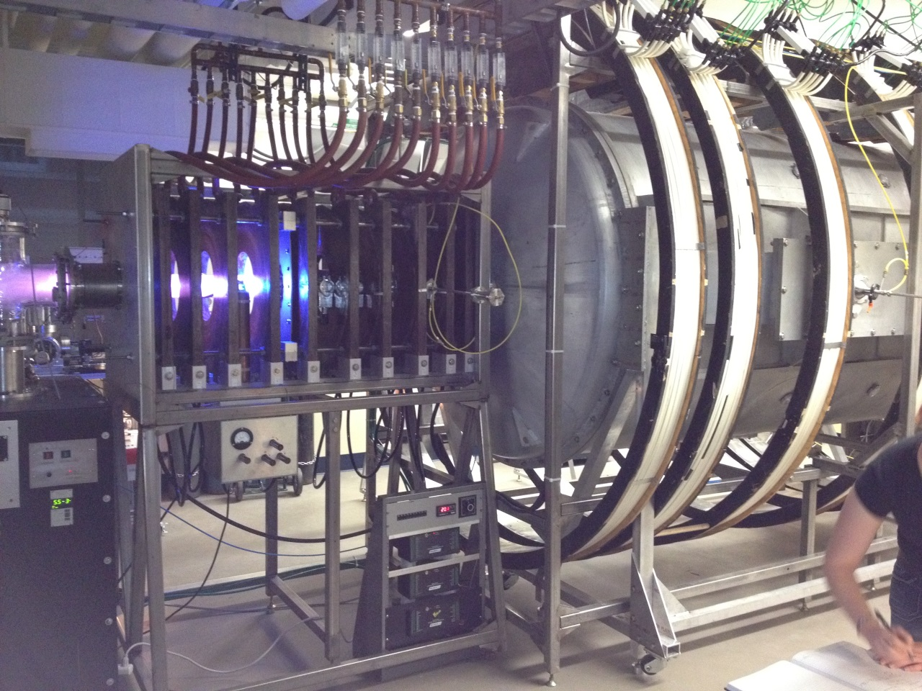
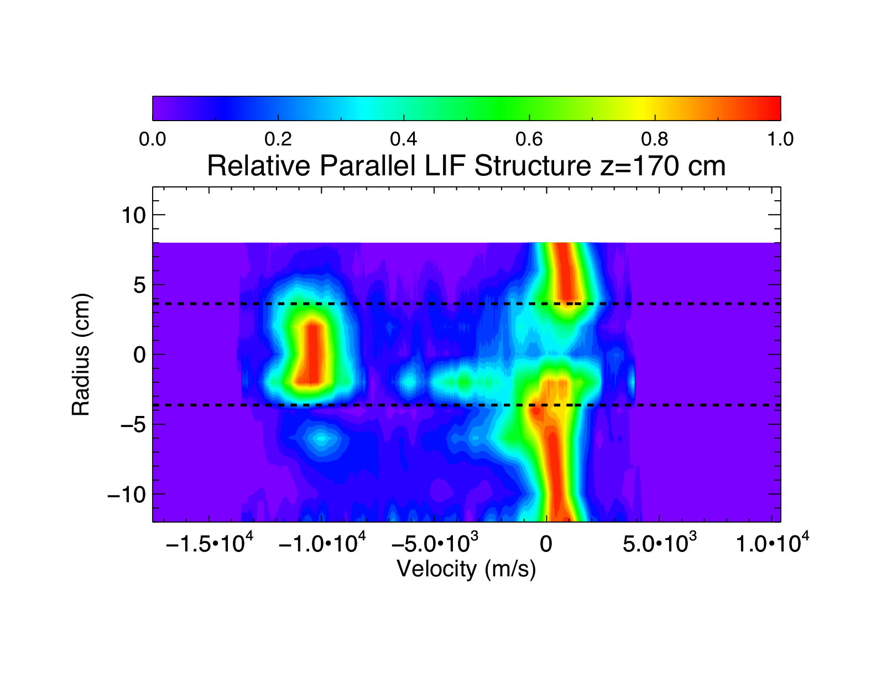
Current Projects – Double Layers

Slide 18
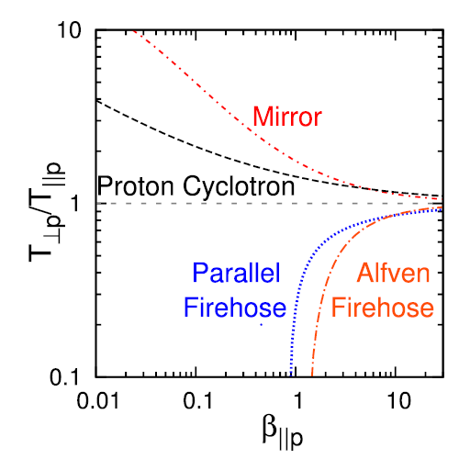
Current Projects – Solar Anisotropic Instabilities
Look at ion temperature in solar winds
Whenever particles enter the instability regions their energy gets redirected or they are ejected in a loss cone
Investigate if this holds for low beta plasmas with LIF and B-Dot probe
K.G. Klein (2015)

Slide 19
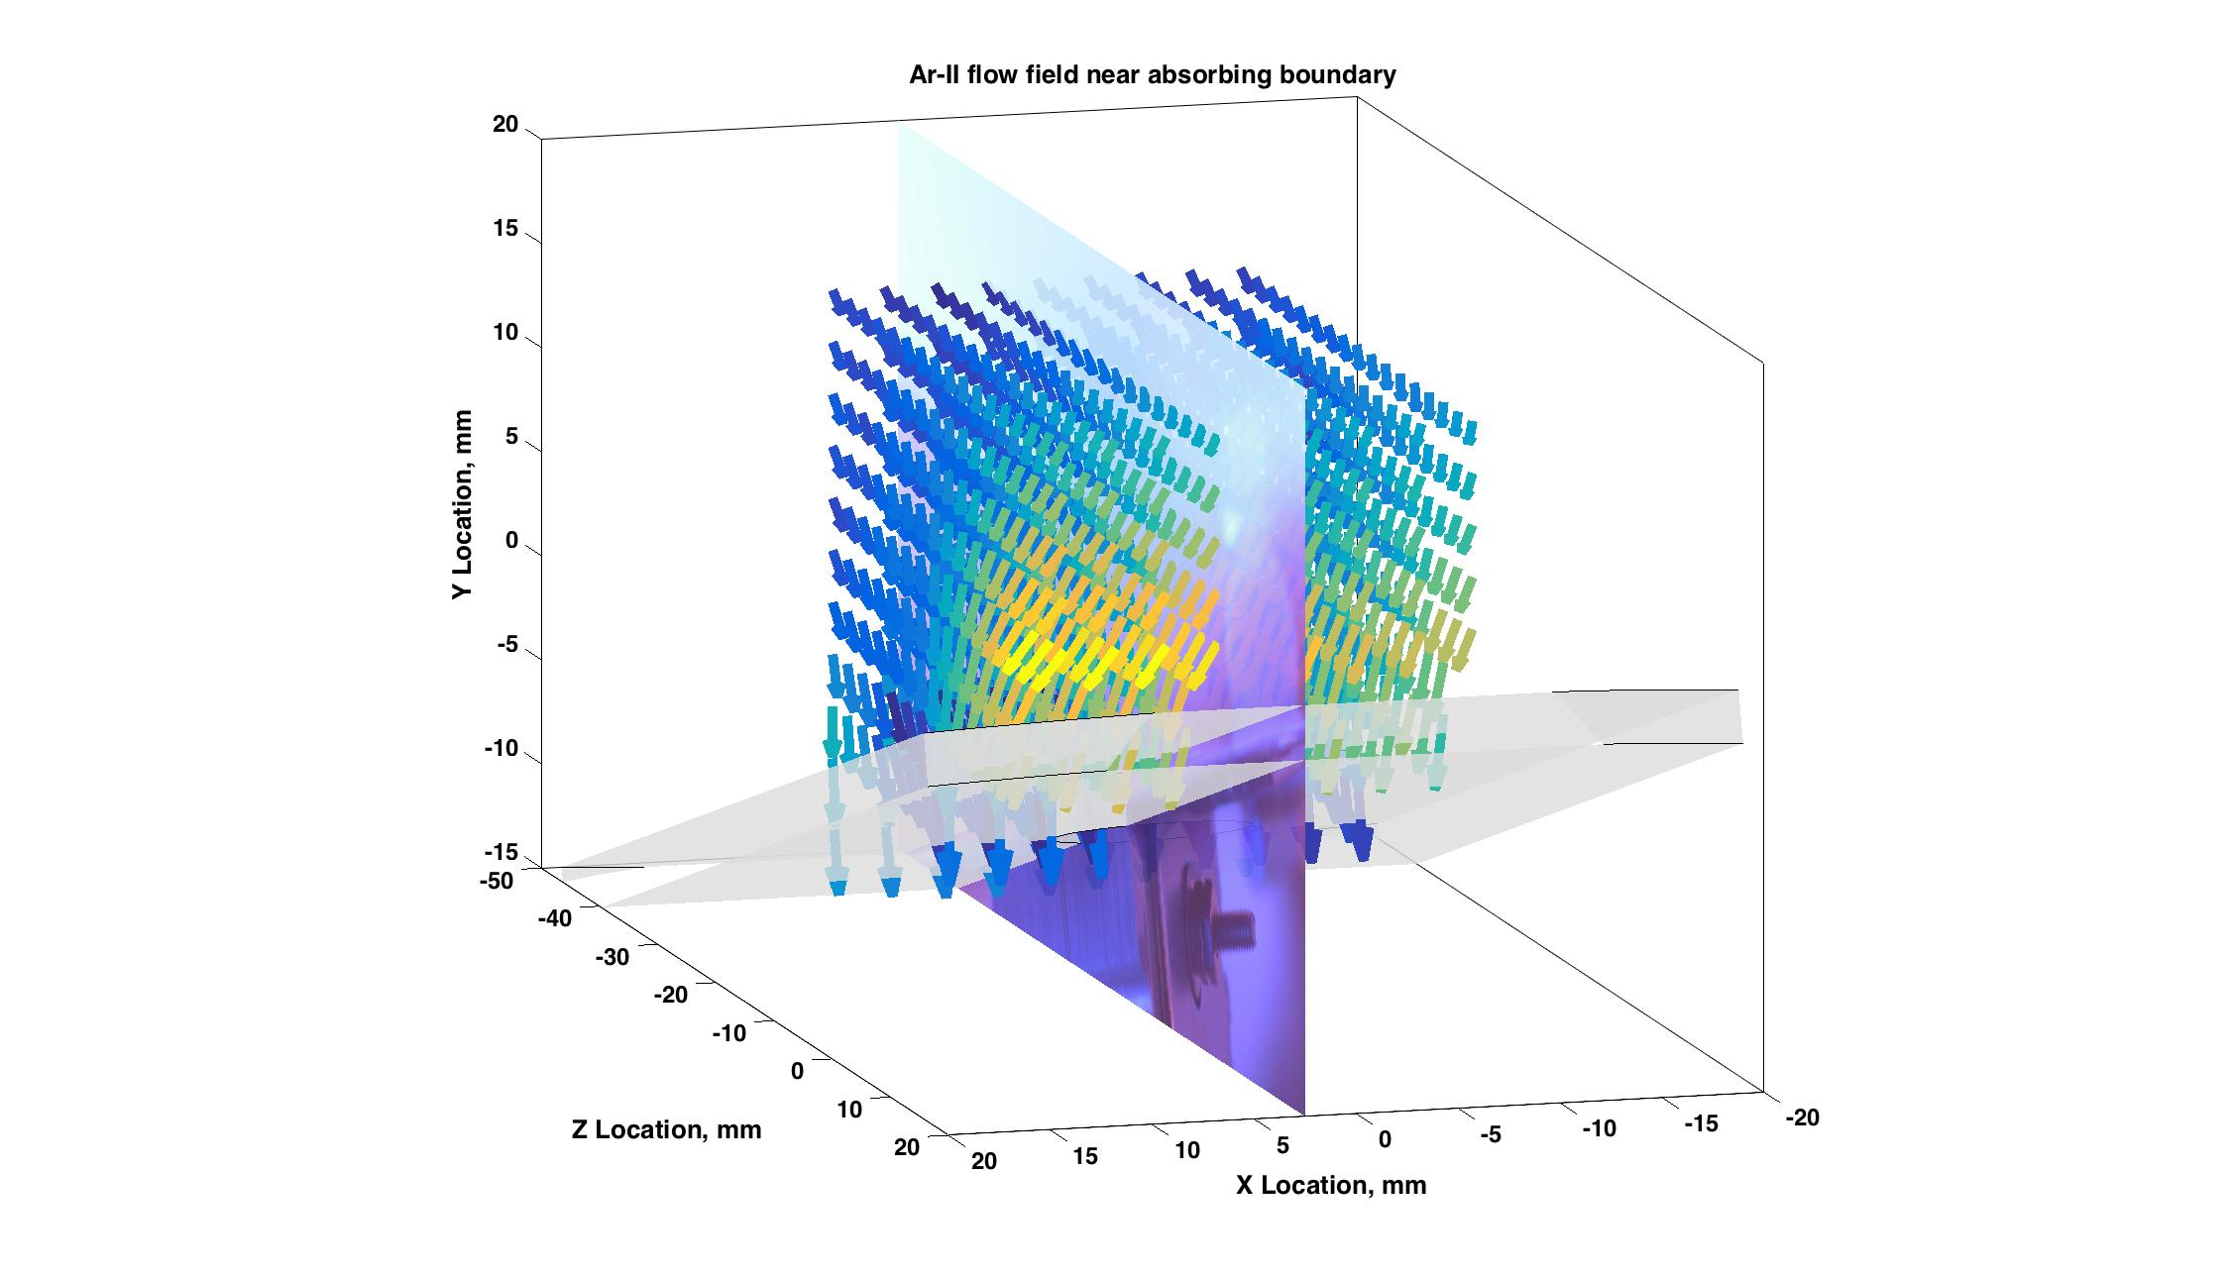
Current Projects – Magnetized sheaths
In collaboration with UIUC – measurements of the full 3D flow field in a 3D volume to investigate the physics of magnetized sheaths for fusion wall and Hall thruster fundamental science.

Slide 20
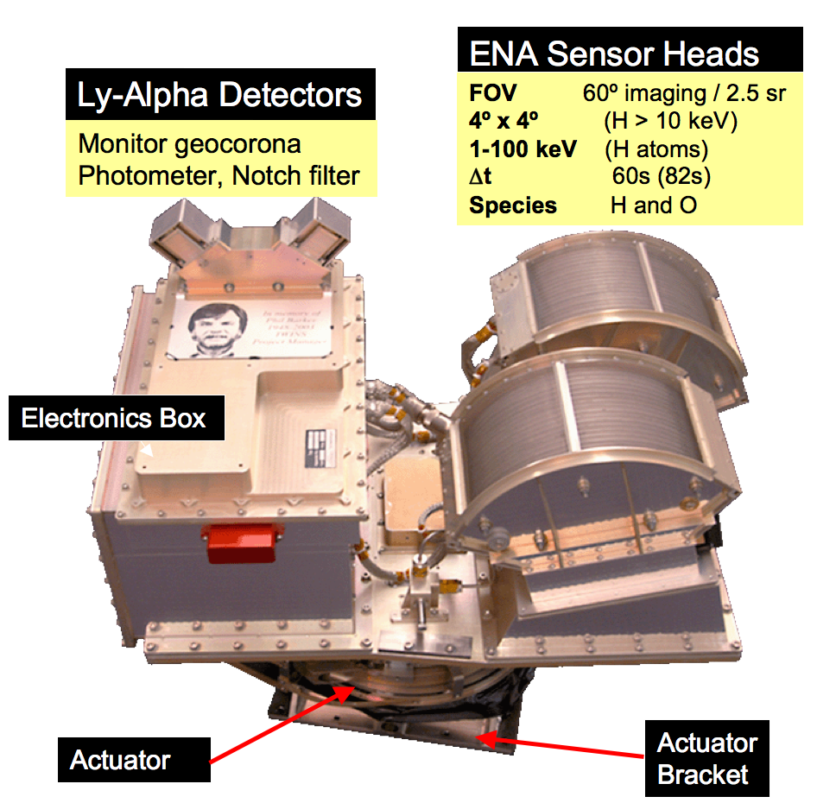
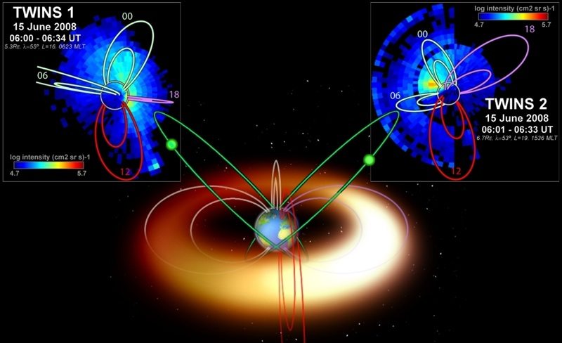
Current Projects – Space Imaging
Look at the Earth’s magnetosphere by imaging charge exchange of neutral atoms (~1-100 keV)

Slide 21
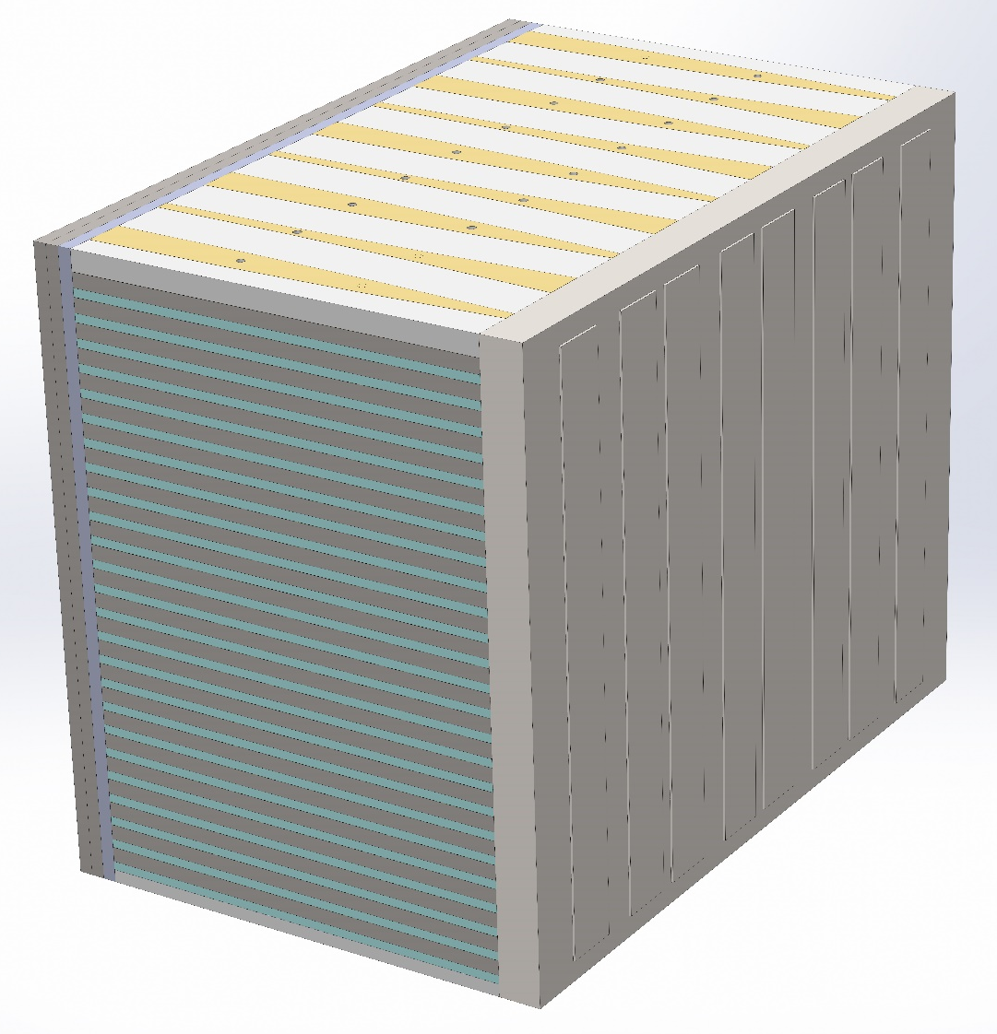
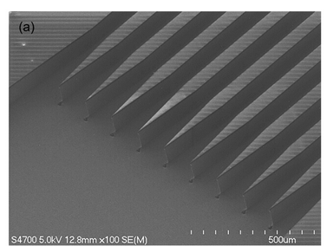
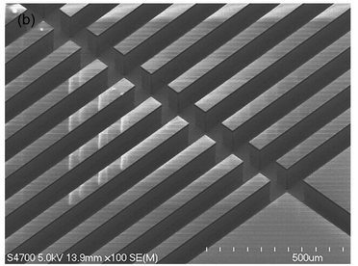
Current Projects- ultra compact plasma spectrometer
In situ probes that can make direct, spatially resolved measurements of the ion energy spectra in the edge of tokamak.
Must be easily replaced and requiring minimal resources.
The ion spectrometers will consist of a combined collimator and energy analyzer fabricated from silicon
Published results as of yesterday: A. M. Keesee, et al. (2018)
I/O and Applied Voltage Top Chip
  Maybe Bottom Chip As Well
8 SSSD Energy Band Pixels

Slide 22
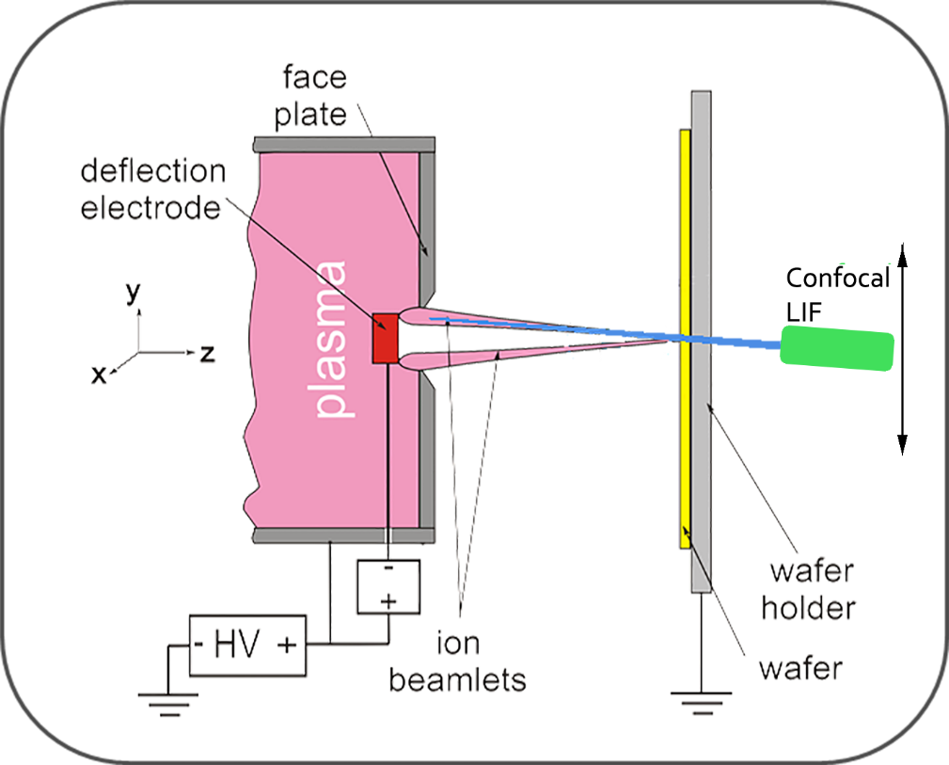
Current Projects – Plasma Etching and Deposition

Slide 23
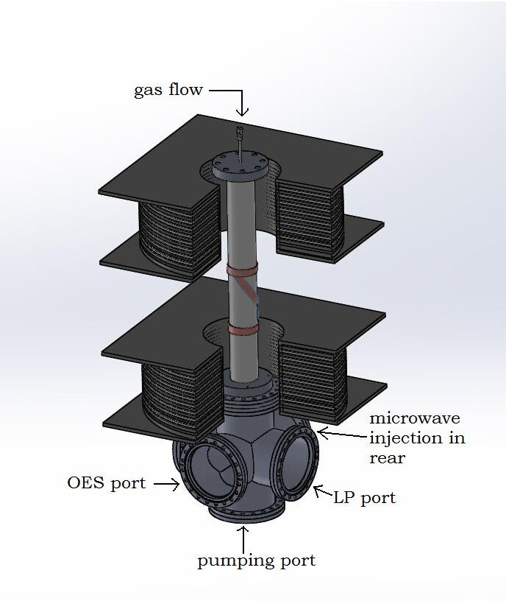
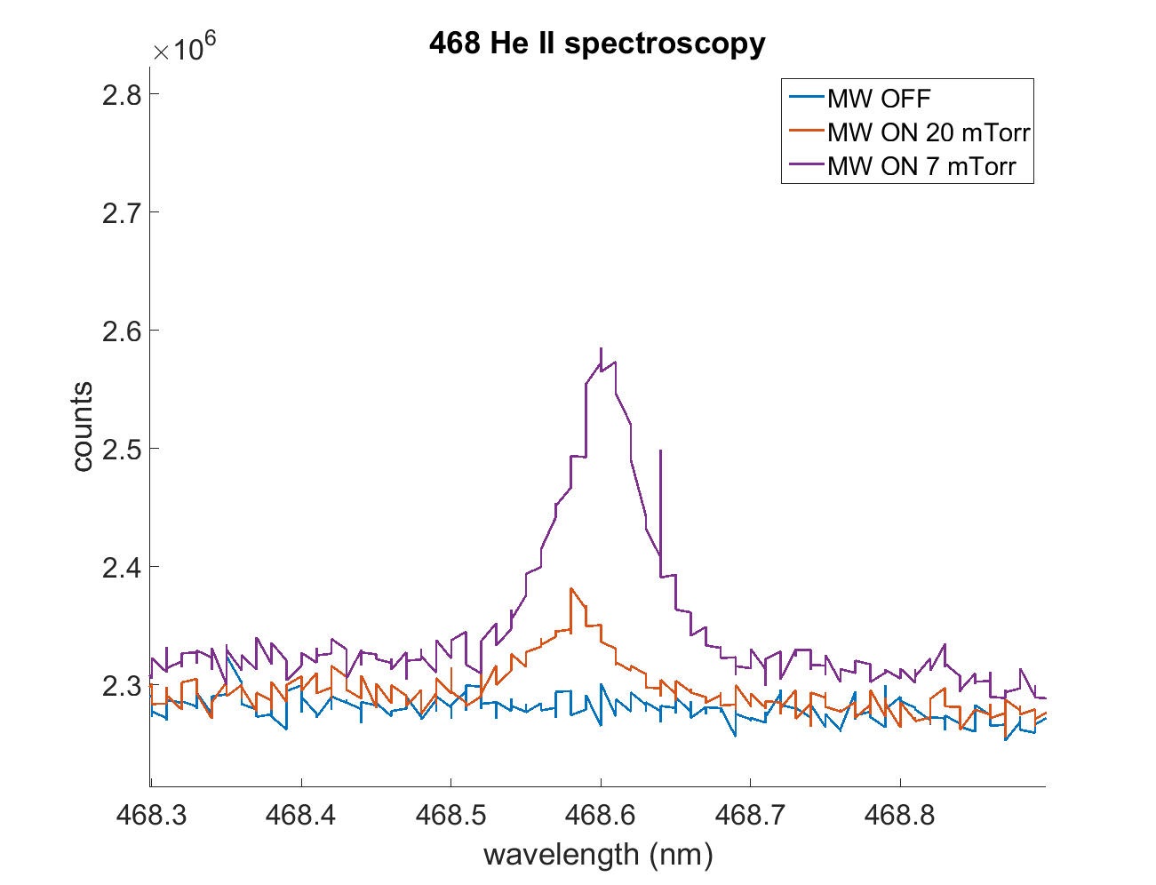
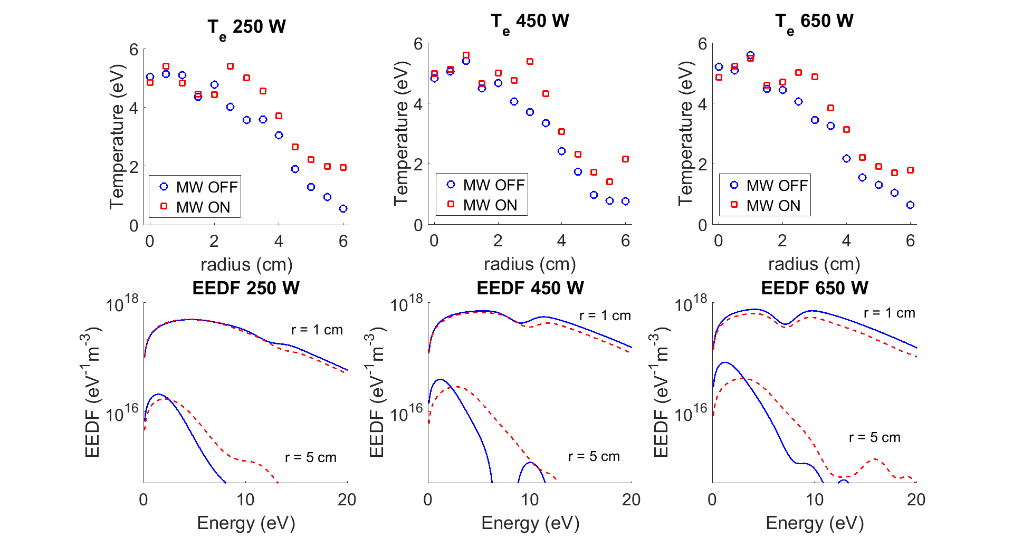
Current Projects – Electron Cyclotron Heating
Wanted to see if x-rays could excite electrons in He plasma to higher energy states
Langmuir measurements and OES confirmed that the electron gained energy and were excited has high as n = 6

Slide 24
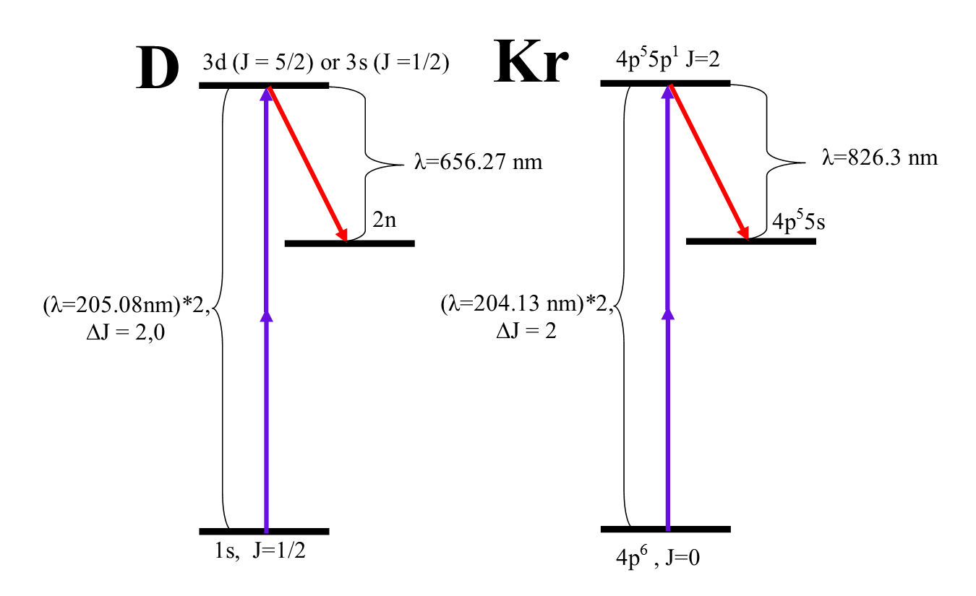
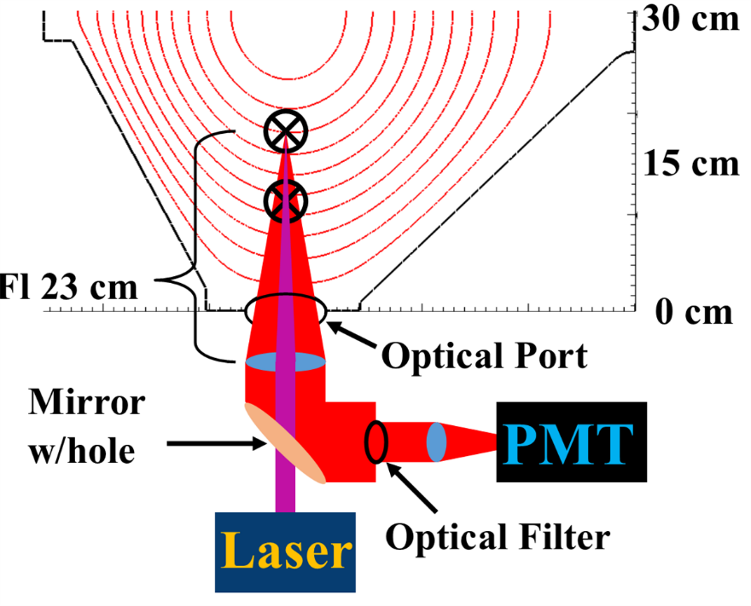
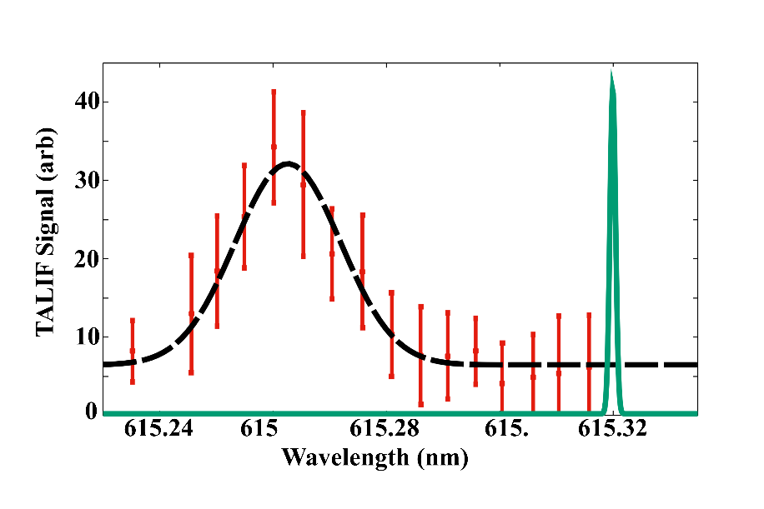
Current Projects – Two Photon Fluorescence

Slide 25
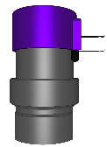
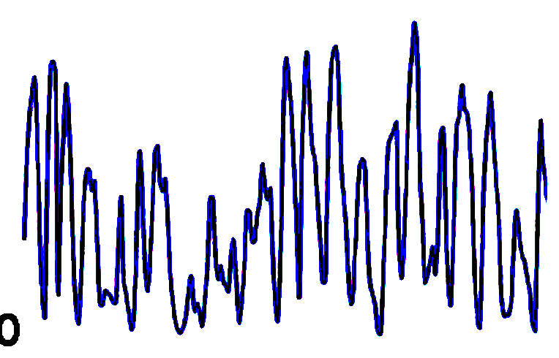

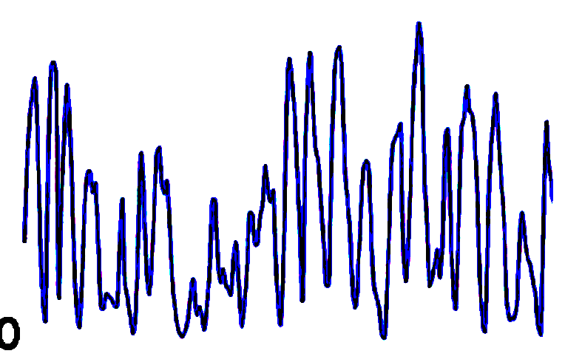
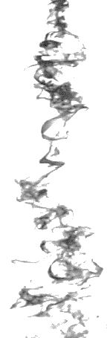
Current Projects – Moth Olfactory Systems
Input signal:
Aim 1
Background flow/ wing beat
1
Input: Odor plume signal
3
2
1
Input: Odor plume signal
Odor cart.
Aim 2
Final plume structure
CCD camera records fluorescence
Planar laser (sheet drives odor-fluorescence
Future Aims
Physiological recording from
Insect olfactory pathway/ psychophysics

Slide 26
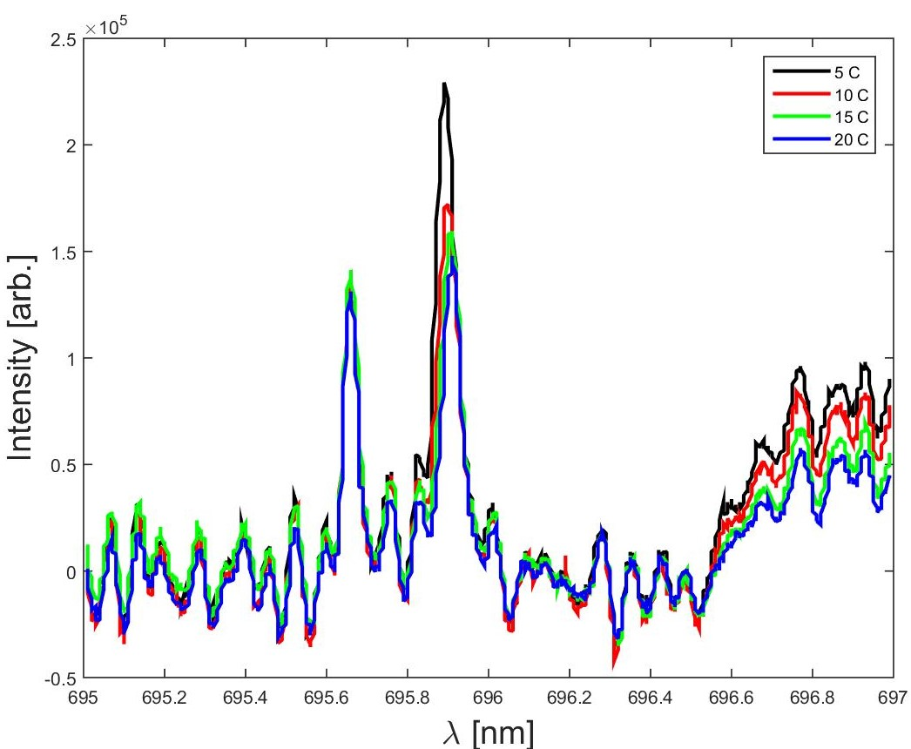
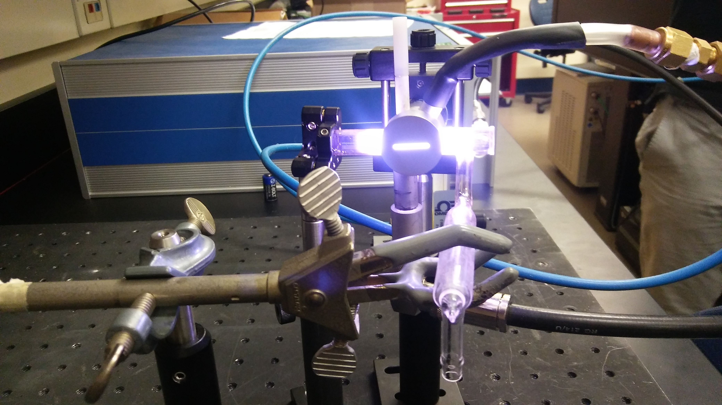
Current Projects – Iodine Electric Propulsion

Slide 27
PHAse Space MeAsurements (PHASMA)
3D LIF in 3D Volume for ivdf
Thompson Scattering for evdf
Microwave scattering
Probes
Reconnection
Turbulence
Shocks

Slide 28
Acknowledgements
Scime Group:
Dr. Derek Thompson, Thomas Steinberger, John McKee, Miguel Henriquez, Jacob McLaughlin, Andrew Jemiolo, Dr. Earl Scime
Arturo Dominguez

Slide 29
References
Figure 2: By Author: ourworldindata.org - Original text : Data source:
https://en.wikipedia.org/wiki/Transistor_countURL: https://ourworldindata.org/wp-
content/uploads/2013/05/Transistor-Count-over-time.pngArticle: https://ourworldindata.org/technological
progress), CC BY-SA 4.0, https://commons.wikimedia.org/w/index.php?curid=71553709
Figure 3: Davide Sacchetto, Design Aspects of Carry Lookahead Adders with Vertically-Stacked Nanowire Transistors
Figure 4: By German Wikipediabiatch, original upload 7. Okt 2004 by Stahlkocher de:Bild:Wafer 2 Zoll bis 8Zoll.jpg, CC BY-SA 3.https://commons.wikimedia.org/w/index.php?curid=928106

